Slide 1

JUNE & JULY 2025
Stock Market
Performance Analysis
DATA ANALYST : GRACE ORIZU

Slide 2

Analysis of stock market performance for June & July 2025.
Examined company and sector performance, volatility, market capitalization, and dividend status.
Goal: Identify trends, highlight top-performing stocks, and assess risk levels to inform investment strategies.
Executive Summary
2025

Slide 3

HOME
ABOUT US
MORE
Dataset covers 82 companies and 10 sectors.
Includes stock prices, market cap, P/E ratios, dividend yields, and trading volumes.
Time period: June - July 2025.
Key metrics calculated:
Daily Return (%) – Open vs Close price.
Monthly Return (%) – Change from start to end of month.
Volatility – Standard deviation of daily returns.
Data Overview

Slide 4

Tools & Technologies Used
1. Programming & Analysis
Python – main programming language.
Pandas – data cleaning, transformation, and analysis.
NumPy – numerical computations.
2. Visualization
Matplotlib – line charts, bar plots, trend visualization.
Seaborn – heatmaps, enhanced statistical graphics.
3. Environment
Jupyter Notebook – code execution, analysis documentation, and visualization integration.
Stock Performance Analysis

Slide 5

KEY MARKET INSIGHTS

Slide 6
TOP GAINERS AND LOSERS
>
>
TOP PERFORMERS
TOP LOSERS
June: Led by Technology & Energy (CRM +0.76%, INTU +0.70%) → growth sentiment strong.
July: Shift to Consumer Staples & Industrials (KO +0.66%, IBM +0.60%) → investor caution showing.
June: Healthcare & Financials hit hardest (GILD -0.69%, BLK -0.64%).
July: Weakness in Consumer Staples & Healthcare (PM -0.50%, REGN -0.48%).
Shows that individual stock performance can sharply diverge from sector averages.

Slide 7
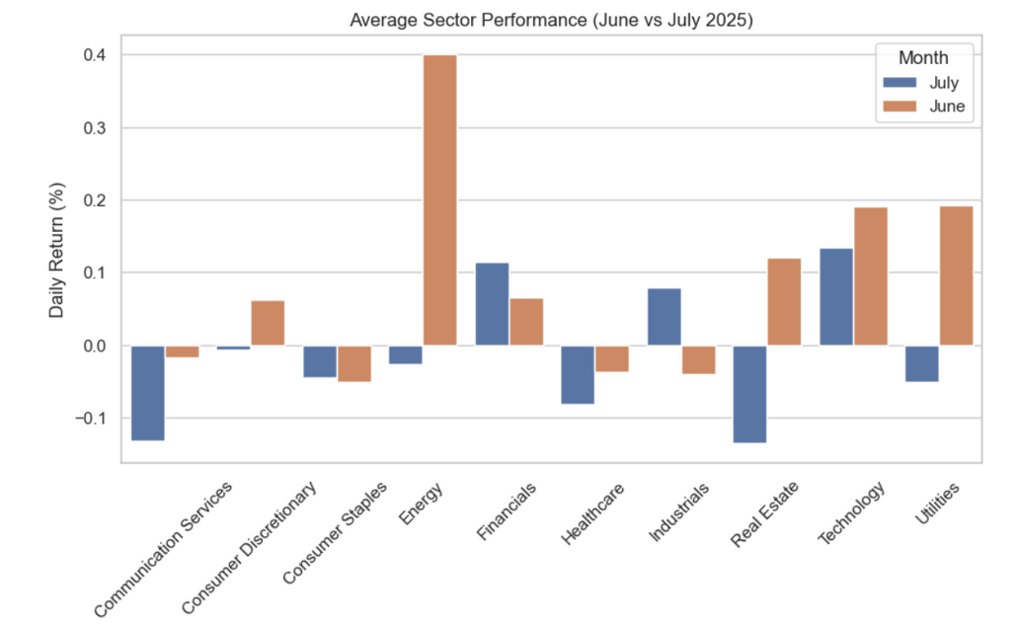
1. Which sectors performed best in June vs July 2025?
Technology led gains in both months, while Healthcare showed mixed results.
Some sectors shifted from growth to decline between June and July.
Sector Performance

Slide 8
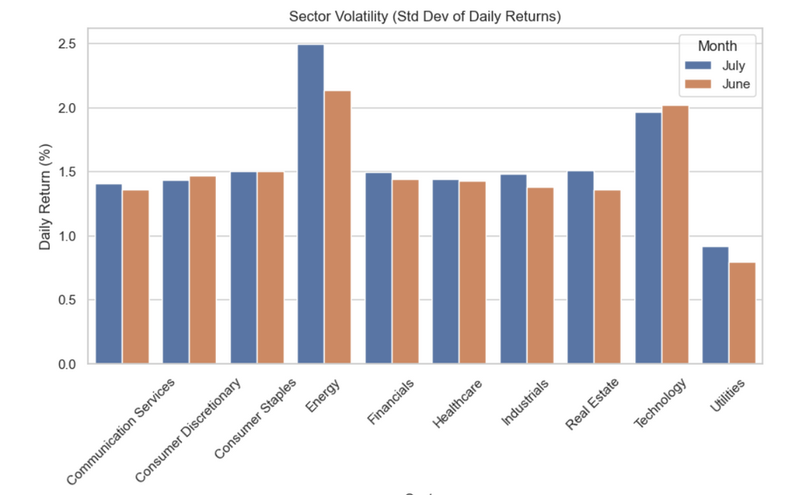
3. Did market volatility increase or decrease from June to July?
Energy and Technology sectors had the highest volatility → higher short-term risk and potential return.
Utilities and Consumer Staples sectors remained stable → lower risk profile.
Volatility Trends

Slide 9
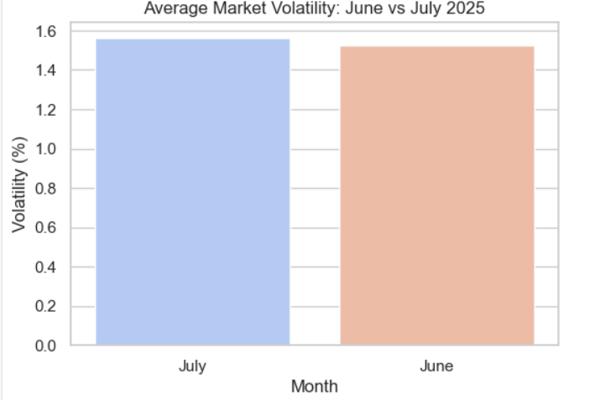
How did market volatility differ between June and July 2025, both on average and across individual tickers?
Market volatility was higher in June than July.
Some stable-sector stocks showed above-average volatility.
Some high-volatility sector stocks stayed below market volatility.
Volatility Trends

Slide 10
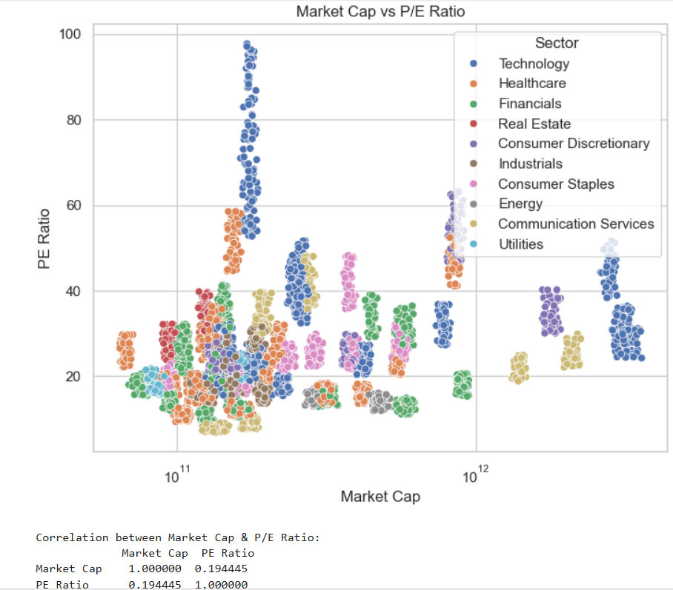
4. Is there a correlation between Market Cap and P/E Ratio?
Weak positive correlation (r = 0.19).
Company size alone does not determine valuation multiples.
Tech and Communication sectors show higher P/E (growth-driven).
Financials, Energy, and Utilities show lower P/E (stable but less growth).
Valuation Relationship

Slide 11
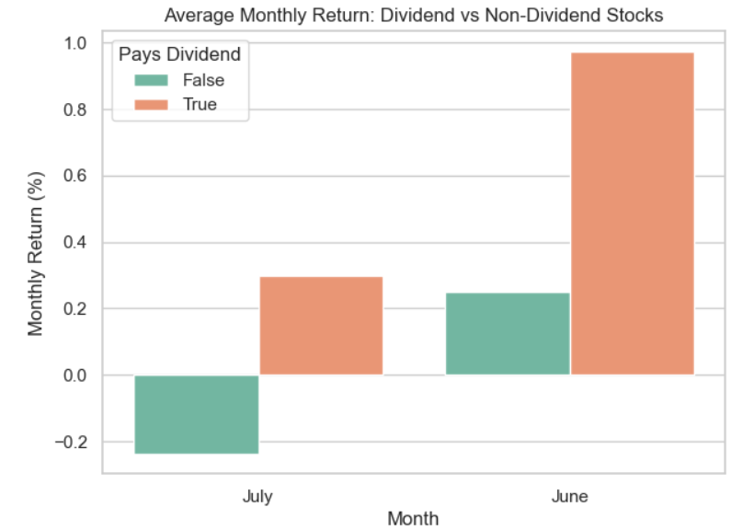
Did dividend-paying stocks outperform non-dividend stocks in this period?
Average market dividend yield was slightly higher in June than in July.
Indicates a modest shift in income potential month-to-month.
Dividend Impact

Slide 12

Potential Shareholder Applications – How it could be used.
Identify Consistent Growth Sectors – Use trend data to spot sectors delivering stable returns over multiple months for long-term positioning.
Manage Risk via Volatility Insights – Apply sector and ticker volatility profiles to decide where to take calculated short-term trades and where to hold safe assets.
Spot Emerging Opportunities – Track top gainers month-to-month to capture momentum plays before they peak.
Reassess Weak Holdings – Review underperforming stocks for potential exit or restructuring.
Enhance Dividend Strategy – Monitor average yield shifts to target periods or sectors with stronger income potential.
Improve Valuation Judgement – Use the P/E vs Market Cap insight to avoid overpaying for companies just based on size.
POTENTIAL SHAREHOLDER APPLICATIONS

Slide 13

The June–July 2025 stock market analysis revealed clear sector trends, top gainers/losers, and varying volatility patterns.
Insights from this dataset can guide sector positioning, risk management, and opportunity spotting for shareholders.
While based on a limited timeframe, the findings show how structured analysis can turn raw data into actionable market intelligence.
It basically says: “We found patterns → they can be useful → this is proof of concept.”
CONCLUSION
“We found patterns → they can be useful → this is proof of concept.”

Slide 14
Thank You.
STOCK MARKET PERFORMANCE
JUNE & JULY2025

